Slide 1
Bell Ringer
What is Ethics?
How do you know if your decision is ethical?
Notes:
Have the students answer this. You can use PollEverywhere or have them break into groups to discuss, use post-it’s etc
Ethics” is best described as
Philosophical concept dealing with moral conduct.
A set of standards establishing right and wrong actions.
Rules that describe your duty to society and to your fellow professionals.
Guidelines that help you make decisons.
It is consistent with your professional moral principles.
It is consistent with generally accepted codes of conduct.

Slide 2

Ethics

Slide 3
Learning Objectives
Demonstrate an understanding of academic honesty ethics, and ethics pertaining to the profession of engineer.
Students gain a better understanding of the variety of factors that influence and cloud a person's judgement when faced with an ethical dilemma.
Understand the bases for making ethical decisions.
Analyze and debate multiple solutions to an ethical dilemma, determine the best alternative available, and describe how the decision maximizes the benefit and minimizes the risk for everyone involved

Slide 4
Ethics” is best described as:
Your decision is ethical if:
Philosophical concept dealing with moral conduct.
A set of standards establishing right and wrong actions.
Rules that describe your duty to society and to your fellow professionals.
Guidelines that help you make decisions.
It is consistent with your professional moral principles.
It is consistent with generally accepted codes of conduct.

Slide 5

Engineering creed
As a Professional Engineer, I dedicate my professional knowledge and skill to the advancement and betterment of human welfare. I pledge:
To give the utmost of performance;
To participate in none but honest enterprise;
To live and work according to the laws of man and the highest standards of professional conduct;
To place service before profit, the honor and standing of the profession before personal advantage, and the public welfare above all other considerations.
In humility and with need for Divine Guidance, I make this pledge.
Adopted by National Society of Professional Engineers, June 1954
Notes:
Engineers and scientists have, by the very nature of their profession, a body of specialized knowledge that is understood only vaguely, if at all, by most of the population.
This knowledge can be used for tremendous good in society, but can also cause untold mischief when used by unscrupulous practitioners.
The Code of Ethics is to provide a code of conduct specific to the profession.
You can have this on a poster in the classroom.

Slide 6
What is Professionalism?
Honesty.
Punctuality.
Commitment to high standards.
Appreciation of personal and ethical responsibilities.
Ability to handle uncertainty.
Ability to communicate effectively, and sometimes in different languages.
Information found from http://www.sefi.be/wp-content/abstracts/1205.pdf

Slide 7
Plagiarism, Academic Integrity, Etc
You should insert a slide or two in here going over your specific school’s academic honesty policy and rules on plagiarising.

Slide 8
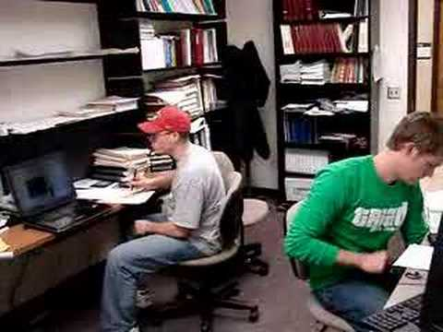
Example - Engineering Ethics
Notes:
3 minute long video
Have a discussion about the ethics and professionalism characteristics that were violated in this video.
Lying to boss
Ignoring student’s input
Knowingly sending something off that is wrong
Assuming others will fix or catch your errors later

Slide 9
Example - Ethics Discussion
Your company has been granted a contract to develop the next generation of electronic cigarette and your group has been assigned as the design team. Can you, in good conscience, contribute your expertise to this project?
What are the steps for making an ethical decision?
Notes:
Here is another example. Read what is on the slide aloud to the class.
Click on the next slide to show the steps for ethical decision makings and work this example as a class, going through and answering all the questions for ethical decision making. (Teacher notes on PDF in folder)
Go through each step. Follow the PDF paper. You can put the answers on the board or have the students write post it’s and place it under each category. Lots of options but keep the students engaged and actively involved in the discussion.

Slide 10

Steps for Ethical Decision Making
Identify the issue and the stakeholder
Analyze alternative courses of action from different perspectives:
Consequences
Intent
Character
Correlate perspectives
Act on your decision– do I have the courage to do what is right?
Picture from www.huffingtonpost.com
Notes:
These are the steps that you take to determine if your actions will be ethical. You should step them through this with the e-cigarette example in the folder.

Slide 11
Project - Ethics Case Study
Notes:
Look in “Slide 8 Projects” folder for potential ethics exercises to run with your class.
These Pesky Side Reactions - student and teacher version in shared folder. You can either have the students do a powerpoint explaining how they would handle each scenario, you can assign them each a particular scenario and have them present on those findings, you can run this like a group discussion where students are given 15-20 minutes in groups to come up with their solution - If you do this, you may want to give group A a second scenario so that they have a bit more to discuss. See Teacher Notes for more detailed information about classroom management for this activity
Alternative activity - There is a various ethics folder where you can select one case for the whole class to analyze or you can assign different ones to different groups. the students will be presenting their ideas on the case so, in an effort to keep the answers different and interesting, it is recommended that you choose a variety of cases from this folder if you do not choose the pesky side effects option.
Alternative activity 2 - Have the students role play an ethical dilemma like the one in the kansas state video.

